Slide 1
Introduction to Processing Digital Sounds part 1
Barb Ericson
Georgia Institute of Technology
Sept 2005

Slide 2
Learning Goals
Learn about sounds
  How do we hear?
  How do we digitize sound?
  Why do we digitize sound?
  How is digitized sound represented?
How to play a sound in Java
  How to create Sound objects
  How to play them
  How to explore them

Slide 3
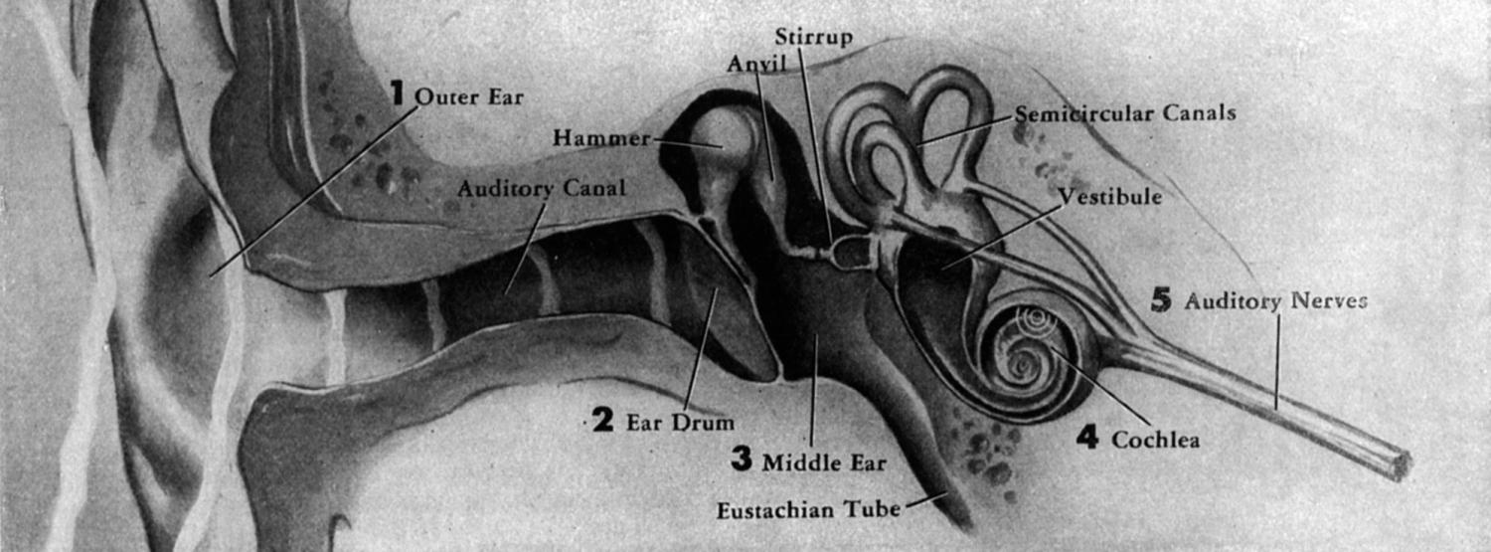
How does Hearing Work?
The outer ear “catches” sounds
The eardrum vibrates
The inner ear translates the vibrations to nerve impulses for the brain to interpret
Notes:
See http://entertainment.howstuffworks.com/hearing.htm for more information on how hearing works.
See http://www.dsokids.com/2001/dso.asp?PageID=132 for how hearing works.

Slide 4
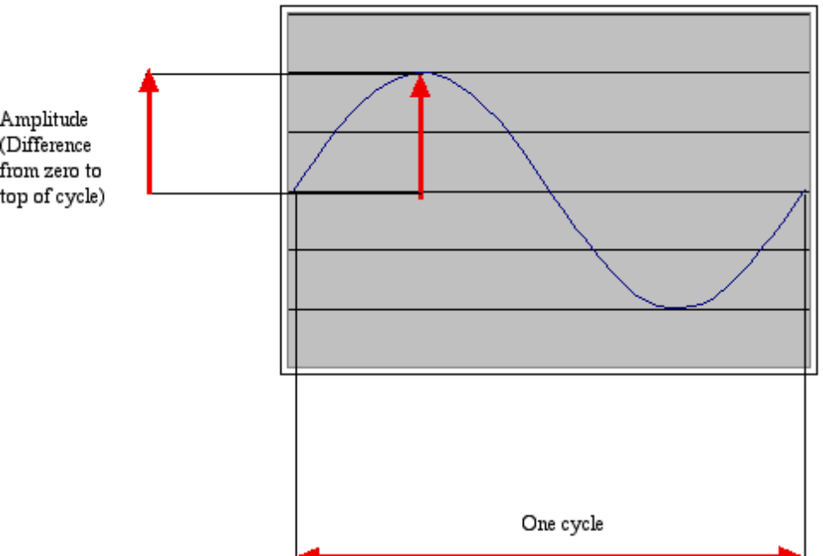
Acoustics, the physics of sound
Sounds are waves of air pressure
  Sound comes in cycles
  The frequency of a wave is the number of cycles per second (cps), or Hertz
    (Complex sounds have more than one frequency in them.)
  The amplitude is the maximum height of the wave

Slide 5
Volume and Pitch
Our perception of volume is related (logarithmically) to changes in amplitude
  If the amplitude doubles, it’s about a 3 decibel (dB) change.
  A decibel is a ratio between two intensities: 10 * log₁₀(I₁/I₂)
  As an absolute measure, it’s in comparison to threshold of audibility
    0 dB can’t be heard.
    Normal speech is 60 dB.
    A shout is about 80 dB
Our perception of pitch is related (logarithmically) to changes in frequency
  Higher frequencies are perceived as higher pitches
  We can hear between 5 Hz and 20,000 Hz (20 kHz)
  A above middle C is 440 Hz

Slide 6
Try It
Attach a microphone to your computer
Open the Windows-MediaTools folder
Drag the mediatools-v5-sa.image file and drop it on SqueakVM.exe
This will start Squeak with the media tools loaded
Click on the Sound Tools window
  It will expand
Click on Record Viewer and Record
  And do high and low sounds in the microphone
    Notice that high sounds have more cycles per second
Click on Quit to exit Squeak

Slide 7
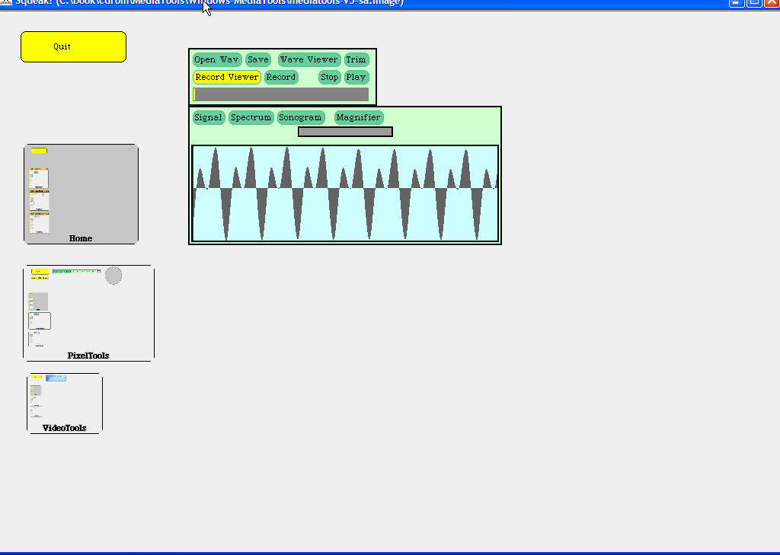
Sound Tools in Squeak
Notes:
For more information on Squeak see http://www.squeakland.org

Slide 8
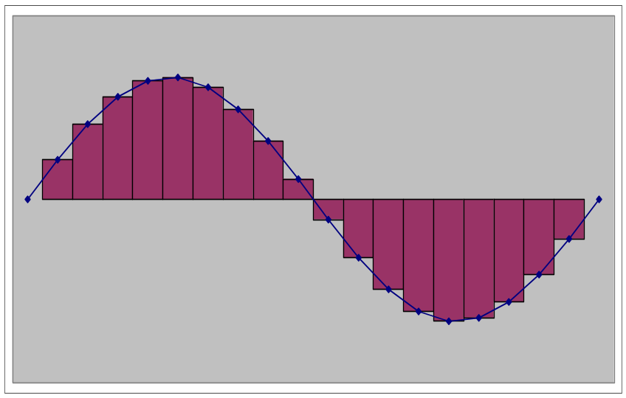
Digitizing Sound
In calculus you learn to estimate a curve by creating rectangles
We can do the same to estimate the sound curve
  Analog-to-digital conversion (ADC) will give us the amplitude at an instant as a number: a sample
  How many samples do we need?

Slide 9
Nyquist Theorem
We need twice as many samples as the maximum frequency in order to represent (and recreate, later) the original sound.
The number of samples recorded per second is the sampling rate
  If we capture 8000 samples per second, the highest frequency we can capture is 4000 Hz
    That’s how phones work
  If we capture more than 44,000 samples per second, we capture everything that we can hear (max 22,000 Hz)
    CD quality is 44,100 samples per second

Slide 10
Try It
Call a friend on a phone and play some music over the phone
  How does it sound?
  Phones only transmit 8,000 samples per second
  The highest frequency you can transmit by phone is 4000 Hz
  This is fine for voice but what does it do to music?

Slide 11

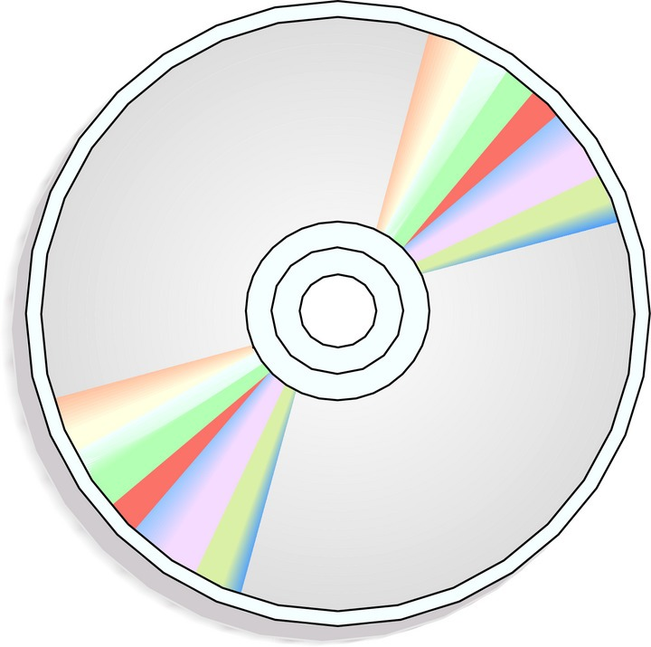
How does Recorded Sound Work?
Phonograph recordings capture sound continuously, as an analog signal
CDs and DVDs sample sounds and record numbers that represent the sound at the time of the sample
  44,100 samples per second
Notes:
See http://entertainment.howstuffworks.com/analog-digital.htm for more information on analog and digital sound recording.
See http://entertainment.howstuffworks.com/analog-digital1.htm for how an analog signal is recorded.
See http://entertainment.howstuffworks.com/analog-digital3.htm for information on how a CD is recorded.

Slide 12
Why Digitize Sound?
High fidelity
  Reproduced sound is very similar to the original
Perfect reproduction
  Sounds the same every time
Easy to transmit
  Download as data
Easier to manipulate on a computer
  Even though there are billions of bits

Slide 13
Playing a Sound
We can create a Sound object just as we created a Picture object
  Get a file name and save a reference to it
    String fileName = FileChooser.pickAFile();
      Pick a file that ends in .wav
  Create the sound object by asking the class to create a new Sound object and initialize it by reading data from the given file name
    Sound sound1 = new Sound(fileName);
  Play the Sound
    sound1.play();
Notes:
Be sure to pick a file that holds a digital sound. These will have the extension .wav.

Slide 14
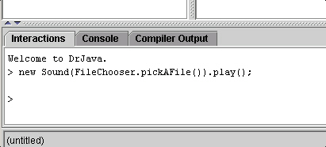
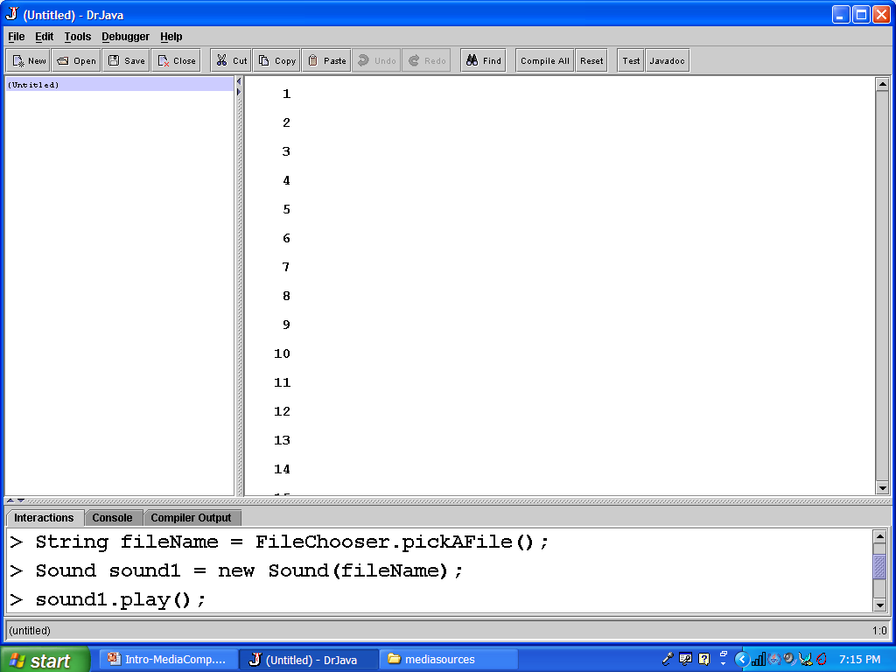
Play Sound Exercise
Try creating a Sound object and playing it by
  Specifying it in steps
  Specifying it all at once
How would you play the same sound twice?

Slide 15
Digitizing Sound in the Computer
Each sample is stored as a number (two bytes)
What’s the range of available combinations?
  16 bits, 2¹⁶ = 65,536
  But we want both positive and negative values
    To indicate compressions and rarefactions.
  What if we use one bit to indicate positive (0) or negative (1)?
  That leaves us with 15 bits
  15 bits, 2¹⁵ = 32,768
  One of those combinations will stand for zero
    We’ll use a “positive” one, so that’s one less pattern for positives so the range is from -32,768 to 32,767

Slide 16
Sound Basics
new Sound(fileName)
  Will create a new Sound object from the data in the file with the passed file name
soundObj.play()
  Will start the sound playing
soundObj.explore();
  Will open a sound explorer on the object
soundObj.blockingPlay()
  Will play the sound and wait to return until the sound is finished
soundObj.write(String fileName)
  Will write out the sound to the file
Notes:
Things in italics will be replaced by actual values when you use the constructor and methods.

Slide 17
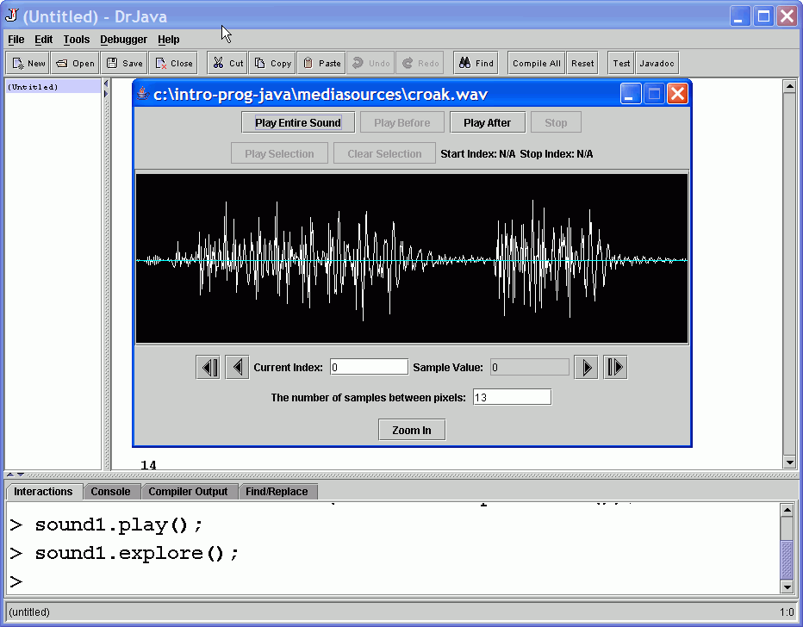
Play and Explore a Sound
Sound
Explorer
Type here
Notes:
The sound explorer shows a graphical representation of a sound. Note that not all the values may be visible since there are many samples in even a short sound. The number of samples between points tells you how many samples are skipped in the visual representation.

Slide 18
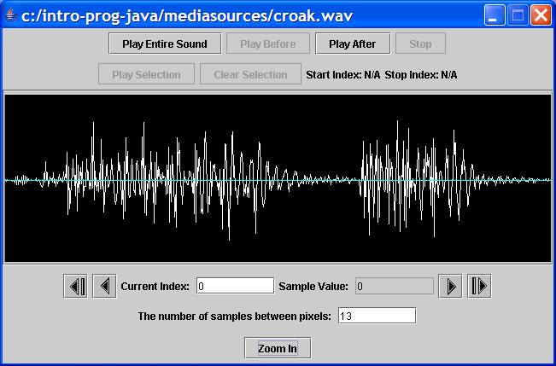
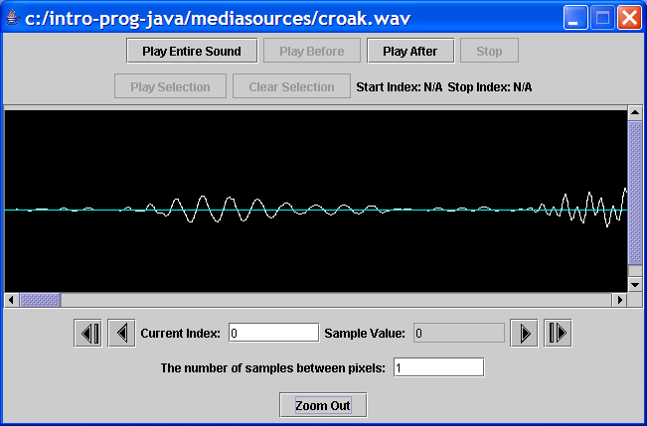
The Sound Explorer
Not all of the sound is shown when you explore a sound
  Skips values to fit in the window
You can zoom in
  To see all sample values
You can zoom out
  To fit the sound in the window again
Notes:
You can also type in the number of samples between pixels.

Slide 19
Summary
Sounds are made by changes in air pressure
  Compression followed by refraction
The pitch is based on the frequency
  Distance between cycles
The volume is based on the amplitude (height of the wave)
  Multiplying the value by > 1increases the volume
We can create Sound objects, play them, explore them, and write them back out to a file
A sound sample is a value from -32,768 to 32,767
We need to capture 2x the max frequency
  44,000 samples per second on a CD for a max frequency of 22,000

